Slide 1
Insights from the first 1000 reviews of British Airways

Slide 2
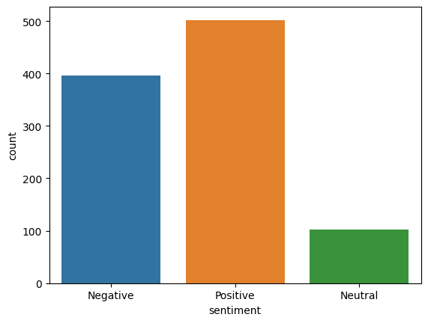
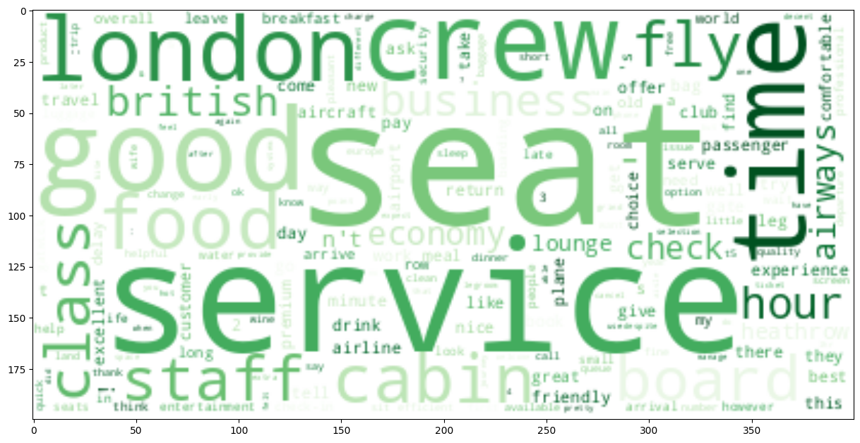
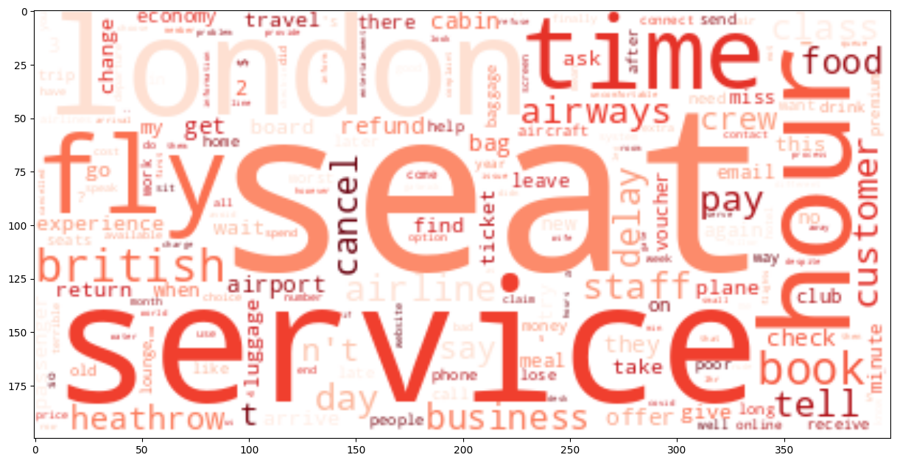
Sentiment Analysis on the reviews tells us the general mood/tone of the review, the results obtained through it tells us the following
Number of positive reviews – 502
Number of negative reviews – 396
Number of neutral reviews – 102
Most common words in the positive and negative reviews are as follows:
By applying Latent Dirichlet allocation on both positive and negative reviews we can obtain the most common topics our customers talk about in the reviews. The following data should help Birtish Airlines understand it’s strengths and weaknesses.
Positives: Service, crew, flight time, food, cabin, meals, seats, Business class
Negatives: Cancellation, Delay, refunds, vouchers, service
In the above reviews, no. of verified trips : 814, no. of unverified trips: 186
Mean review lengths: Positive responses: 81, Negative responses: 78

